Slide 1
SMART IRRIGATION SYSTEM
An IoT-based solution for efficient water use in agriculture
Presented by GreenTech

Slide 2
🌱 INTRODUCTION
Efficient water use is a major challenge in farming, as fixed irrigation schedules often lead to overwatering or underwatering crops, which can waste water and reduce yields.
Our project, the Smart Irrigation System, addresses this problem by automatically watering plants based on soil moisture and temperature.

Slide 3
🎯 PROBLEM STATEMENT
Farmers often irrigate crops on fixed schedules, regardless of actual soil moisture or weather conditions. This approach can lead to overwatering, wasting valuable water resources, or underwatering, which reduces crop yield and quality.

Slide 4
⚙️AIM & MISSION
The aim is to design and implement a Smart Irrigation System that automatically waters plants based on real-time soil moisture and temperature readings, ensuring efficient water use and optimal crop growth.
The mission is to promote sustainable and efficient farming practices by developing an automated irrigation system that monitors soil and environmental conditions, reduces water wastage, and supports healthy crop growth.

Slide 5
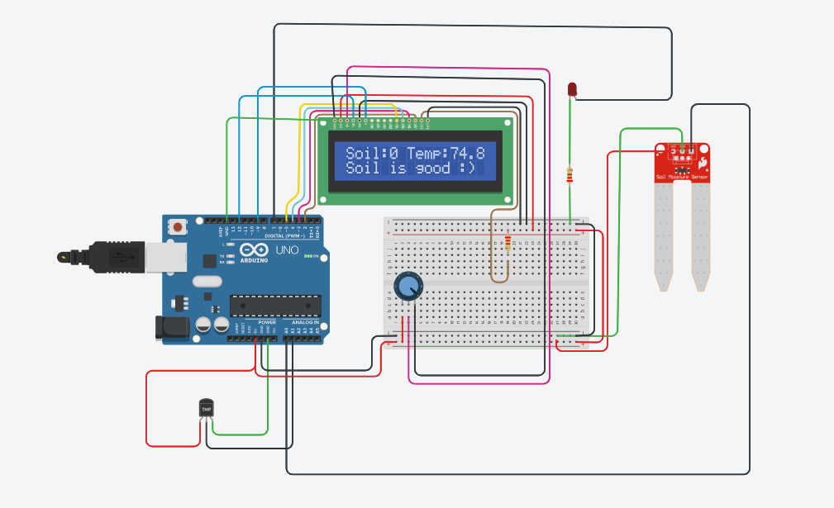
💡 PROPOSED SOLUTION
A Smart Irrigation System that automatically controls water supply based on soil moisture and temperature. Using sensors to monitor conditions, the system determines when irrigation is necessary.

Slide 6
💡 BENEFITS
It saves water and energy
Promote precision farming
Requires minimal human intervention
It promotes plant health and production yield
Avoid erosion and overwatering and underwatering the plants

Slide 7
🌾 CONCLUSION
The Smart Irrigation System demonstrates the transformative potential of IoT in agriculture. By automating irrigation based on real-time data, farmers can conserve water, improve crop yields, and reduce manual labor. This project highlights how technology can drive sustainable agricultural practices.

Slide 8

THANK YOU

